Slide 1

Guidelines for Promotion
and Appointment

Slide 2
Agenda
Promotion Workshop for Public Service and Outreach
Promotions Coordinators and Interested Faculty
Thursday, March 19, 2026
10:00 a.m. (Promotions Coordinators, J.W. Fanning Building)
1:30 p.m. (Interested Faculty, Zoom)
Welcome, Guideline Changes and Promotion Calendar………………………………….…………. Matt Bishop
Guidelines for Appointment and Promotion………………………………………………….………... Danny Bivins
Organizing a Dossier for Promotion……………………………………………………………….………. Keri Hobbs
Promotion Procedures………….……………………………………………………………………..….……. Matt Bishop
outreach.uga.edu

Slide 3

Where to Download
Copies of this publication may be downloaded at the following link:
http://outreach.uga.edu/policies/appointment-and-promotion-guidelines/
Then click
Guidelines for Appointment and Promotion (PDF)
Changes of Note (Revised 2025) (PDF)
Workshop Video
Calendar
outreach.uga.edu

Slide 4
Major Changes to Appointments & Promotion Guidelines
Part I
Senior Public Service Associate
Section 3: An advanced degree is required, and a terminal degree is expected. (page 5)
Part IV
Promotion Procedures for Public Service and Outreach Faculty
Outlines different committee levels and recommendation levels of unit/department/college
and roles of deans/directors/department heads in that process. Provides guidance on
who should be considered for service on committees. (pages 18-19)
Clarifies that activities occurring after October 1 of the year in which the candidate submitted
a dossier that was successfully promoted can be included in the next promotion dossier.
(page 21)
Creates page limits for cover letter and curriculum vitae. (pages 20-21)
Clarifies that no more than 5 letters of evaluation can be included. (page 22)
Adds an “Appendix” section for the candidate’s annual written evaluations. (page 23)
outreach.uga.edu

Slide 5
Promotions Calendar 2026-2027 (1)
February 2026
Unit Directors/Deans/Department Heads notify faculty and coordinators of promotions procedures, regulations, and dates for workshop/orientation
March 19, 2026
Promotions Guidelines Orientation for College/School/Unit Promotion Coordinators
(10:00 am – 12 noon; Fanning)
Promotions Faculty Workshop
(1:30 pm – 3:30 pm; Zoom)
May 2026
Annual Promotions Memorandum Reminder from the Vice President for Public Service and Outreach
July 2026
Names of potential promotion candidates are to be submitted to the
Office of the Vice President for Public Service and Outreach per the
deadline established by the Office of Faculty Affairs.
outreach.uga.edu

Slide 6
Promotions Calendar 2026-2027 (2)
September 2026
Appointment of Public Service and Outreach (PSO) Promotions Committee (University-level)
October 5, 2026
Promotions dossiers due to the Office of the Vice President for Public Service and Outreach
November 5, 2026
University committee deliberations
January 6, 2027
Promotions due to the Office of the Senior Vice President for Academic Affairs and Provost
outreach.uga.edu

Slide 7
Promotions Calendar 2026-2027 (3)
NOTE:
Immediately following university committee deliberations, Unit Directors/Deans/Department Heads will be notified of any dossier in their respective unit that was not recommended for promotion by the PSO Promotions Committee.
Appeal requests for any dossier not recommended by the committee must be submitted to the Vice President for Public Service and Outreach within seven days after notification of an unapproved recommendation.
Final promotion decision and notification is sent to Unit Directors, Deans, or Department Heads after approval for promotion from Provost and President.
outreach.uga.edu

Slide 8
Guidelines for Appointment and Promotion
Danny Bivins
Senior Public Service Associate
(706) 583-0856
dbivins@uga.edu

Slide 9
Public Service Assistant
Public service assistant is the sole entry level for public service faculty rank.
This rank is comparable to that of assistant professor.
Competency should be supported through academic preparation and/or experience appropriate to the duties and requirements of the position.
An advanced degree is expected.
A documented record of professional growth and development is required.
A documented record of consistent productivity of superior quality in work assignments is required.
Demonstrated impact is required.
outreach.uga.edu

Slide 10
Public Service Associate
This rank is comparable to that of associate professor.
Competency should be supported by academic preparation and experience in a field appropriate to the duties of the position.
An advanced and/or terminal degree is expected. (See Note 4 on pages 7-8.)
A documented record of professional growth and development is required.
A documented record of consistent productivity of superior quality in work assignments is required.
Demonstrated impact is required.
A documented record of meaningful and synergistic collaboration is required, which clearly specifies the candidate’s role and level of contribution, and the overall impact of the collaboration. (See Note 5 on page 8.)
outreach.uga.edu

Slide 11
Public Service Associate - Continued
Tangible evidence of contributions to the body of knowledge or practice in his/her chosen field is required. (See Note 6 on pages 9-10.)
Recognition as a regional and/or emerging national leader in his/her field is required. (Regional is defined as any area outside a person’s assigned geographic responsibility, specified in the candidate’s job description.)
In addition to meeting the criteria outlined above, a minimum of four years at the public service assistant rank is expected (counted from the date of his/her appointment or last promotion, including the current year). (See “Minimum Years in Rank” on page 16.)
    Page 16: The number of years alone does not denote the eligibility of the candidate for promotion. Likewise, this guideline does not prohibit the earlier promotion of a candidate of outstanding merit. However, only especially meritorious candidates should be recommended for promotion within shorter periods.
outreach.uga.edu

Slide 12
Important for Associate Candidates!
  Demonstrated impact
  Regional and/or national reputation
  Evidence of contributions to the body of knowledge or practice (“Peer Reviewed”)
  A documented record of professional growth and development
  Meaningful and synergistic collaboration (including role, level of collaboration, and overall impact)
  Advanced and/or terminal degree is expected
outreach.uga.edu

Slide 13
Important for Associate Candidates - Continued
  Collaboration with one or more of the following categories:
  Public Service and Outreach faculty in another Public Service and Outreach Unit at UGA or with similarly ranked faculty or professional associate with a mission of public service and outreach at another accredited institution of higher education;
  Academic rank faculty at UGA or similarly ranked faculty at another accredited institution of higher education;
  Professionals at appropriate agencies, associations, organizations, or offices that are not clients or direct beneficiaries of the candidate’s public service and outreach work, but in collaboration extend the reach and impact of the candidate’s work.
outreach.uga.edu

Slide 14
Senior Public Service Associate
This rank is comparable to that of professor.
Competency should be supported by academic preparation and/or experience in a field appropriate to the duties of the position.
An advanced degree is required, and a terminal degree is expected. (See Note 4 on pages 7-8.)
A documented record of professional growth and development is required.
A documented record of consistent productivity of superior quality in work assignments is required.
Demonstrated impact is required.
A documented record of meaningful and synergistic collaboration is required, which clearly specifies the candidate’s role and level of contribution, and the overall impact of the collaboration. (See Note 5 on page 8.)
outreach.uga.edu

Slide 15
Senior Public Service Associate - Continued
Tangible evidence of contributions to the body of knowledge or practice in his/her chosen field is required (See Note 6 on pages 9-10.)
Recognition as a national and/or international leader in his/her chosen field is required.
In addition to meeting the criteria outlined above, a minimum of five years at the public service associate rank is expected (counted from the date of his/her appointment or last promotion, including the current year). (See “Minimum Years in Rank” on page 16.)
    Page 16: The number of years alone does not denote the eligibility of the candidate for promotion. Likewise, this guideline does not prohibit the earlier promotion of a candidate of outstanding merit. However, only especially meritorious candidates should be recommended for promotion within shorter periods.
outreach.uga.edu

Slide 16
Important for Senior Associate Candidates!
  Demonstrated impact
  National and/or international reputation
    Evidence of contributions to the body of knowledge or practice (“Peer Reviewed”)
  A documented record of professional growth and development
  Progressive level of meaningful and synergistic collaboration (including role, level of contribution and overall impact)
  An advanced degree is required, and a terminal degree is expected
outreach.uga.edu

Slide 17
Important for Senior Associate Candidates - Continued
    Collaboration including two or more of the following categories:
    Public Service and Outreach faculty in another Public Service and Outreach Unit at UGA or with similarly ranked faculty or professional associate with a mission of public service and outreach at another accredited institution of higher education;
    Academic rank faculty at UGA or similarly ranked faculty at another accredited institution of higher education;
    Professionals at appropriate agencies, associations, organizations, or offices that are not clients or direct beneficiaries of the candidate’s public service and outreach work, but in collaboration extend the reach and impact of the candidate’s work.
outreach.uga.edu

Slide 18
Clarification of Terms
Terminal degree
Collaboration
Leader in field
Regional, National, International
Documented record
Demonstrated impact of work
Early promotion
Recognition of lack of degree or years in rank
Contribution to body of knowledge or practice (peer reviewed)
outreach.uga.edu

Slide 19
Organizing a Dossier for Promotion
Keri Hobbs
Senior Public Service Associate
(706) 583-0052
klgandy@uga.edu

Slide 20
Getting Started
Read the Guidelines
http://outreach.uga.edu/policies/appointment-and-promotion-guidelines/
Then click
Guidelines for Appointment and Promotion (pdf)
outreach.uga.edu

Slide 21
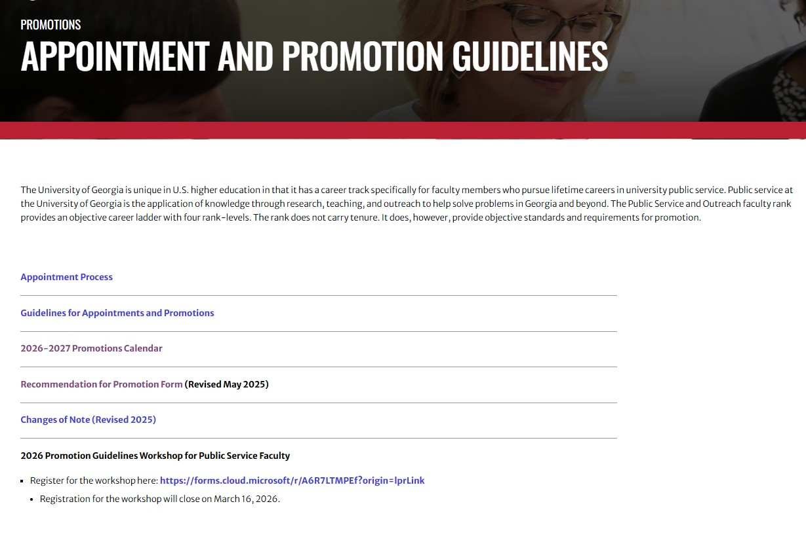
Verify Current Information
outreach.uga.edu

Slide 22
File 1
Section A: Cover, Table of Contents, and Cover Letter
Cover page inserted inside the clear front cover binder. (pg. 30)
Table of contents including page numbers
Cover letter written by Dean, Director, Dept. Head and typically includes:
  Scope and quality of job performance
  Contribution to profession and service
  Description of impact, reputation, collaboration
  Must address lack of terminal degree, early promotion, or limited-termed status
Weighed heavily by committee
Six (6) pages maximum
outreach.uga.edu

Slide 23
Section B: Curriculum Vita
Your full name, office address, telephone number, and UGA email address should appear at the top of your CV
Summary of biographical data
Reverse Chronological Order
Professional experience & career accomplishments
Can span entire public service career
List most recent activities first
Note clearly the activities since last promotion/appointment
Clearly distinguish activities that occurred since appointment or last promotion. Can include activities occurring after October 1 of the year in which the candidate submitted a dossier that was successfully promoted so long as those materials were not already counted toward appointment or a prior promotion. See page 21.
Thirty (30) pages maximum.
Suggested sections…
outreach.uga.edu

Slide 24
I. The Resume
Name (Full official name)
Title
Organization
Current PSO Rank and date promoted
Phone number/UGA E-Mail/current UGA mailing address
Education (academic and special certifications)
Employment and/or professional appointments
outreach.uga.edu

Slide 25
II. Professional and Academic Service
University, Department/Unit, Professional Association activity
Professionals Association memberships
Awards and honors
Professional leadership and/or conference leadership positions
Committee assignments
Events coordinated
Internal presentations; materials developed
Mentoring experiences
outreach.uga.edu

Slide 26
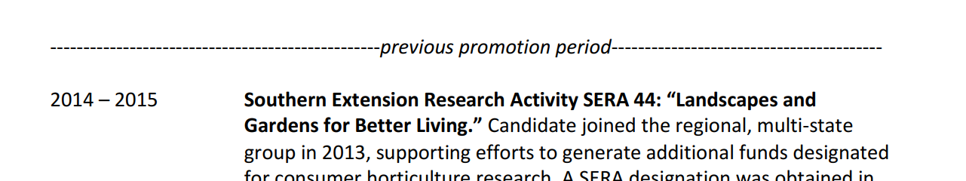
Remember to delineate new material from previous promotion period!
Change the color of the text
Draw a line
Make it very obvious!

Slide 27
III. Program Accomplishments
Presentations, training and instruction
Invited lectures
Exhibitions
Media outreach
Grants and financial awards received
Consultation and/or technical assistance
Applied research
Collaborative programming
outreach.uga.edu

Slide 28
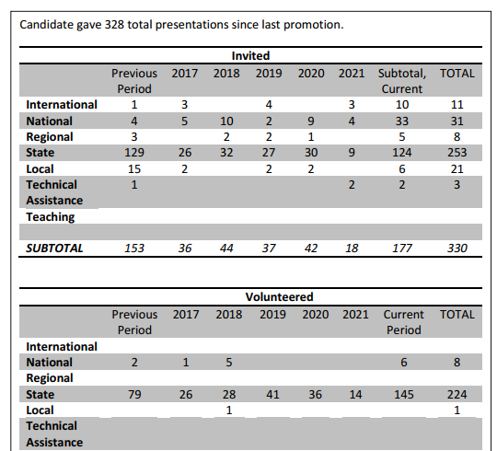
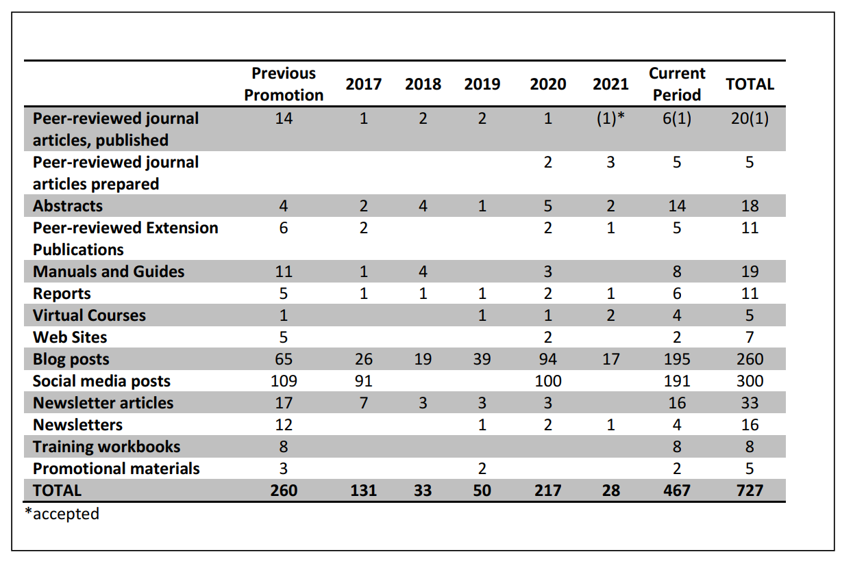
Make it easy on your reviewers

Slide 29
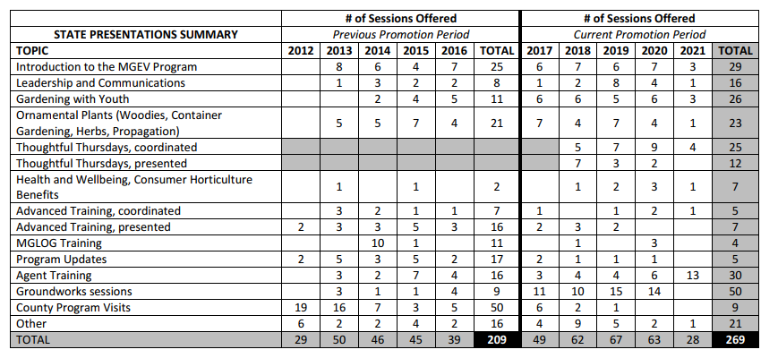
Remember your page limits

Slide 30
IV. Scholarship
Publications developed
Books written
Articles written
Exhibits developed
Media developed
Curricula developed
Special materials
outreach.uga.edu

Slide 31
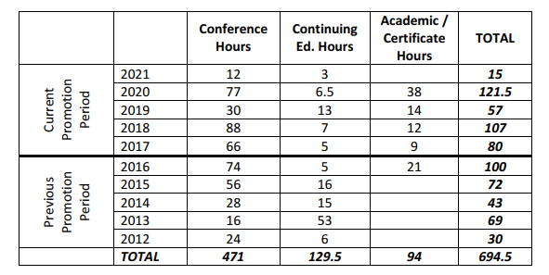
V. Professional Development
Conferences attended
Classes/Courses
In-service training
Advanced degree special projects
Non-academic education
Certifications
outreach.uga.edu

Slide 32
Other Possible Sections
Supervision/Administration
Service to community
Other awards or services
outreach.uga.edu

Slide 33
Section C: Job Description
Must correspond with Achievement section
Academic preparation and experience
Assigned geographic work area
Required skills and attributes
Responsibilities
If occupied more than one job since last promotions, aspects of each job should be delineated and noted
Three (3) pages maximum
outreach.uga.edu

Slide 34
Section D: Documentation of Achievements
Achievements and outstanding contributions since last appointment or promotion (See note on page 21 regarding activities from October 1 of prior submission)
Organized around issues/programs/body of work
Describe significant contributions
Explain collaborative efforts
Emphasize impact, results, outcomes
Describe the importance and complexity of the work
Redundancy is a good thing
Clarify role in work
Cross reference to supporting evidence
Thirty (30) pages maximum (documentation + supporting evidence = 30 pages)
Additional content referenced and located using QR codes or other electronic links will not be considered
outreach.uga.edu

Slide 35
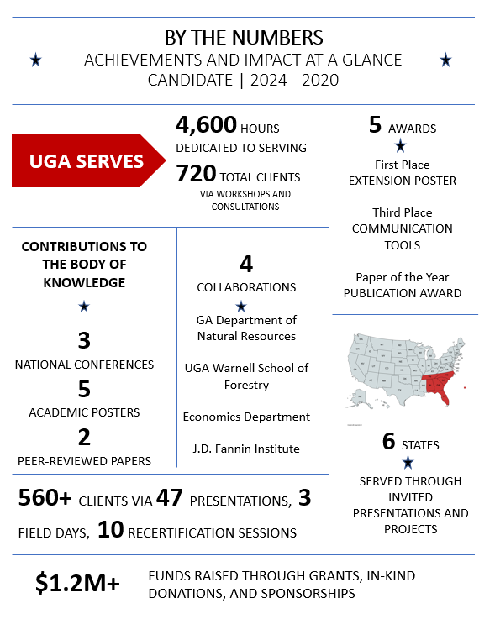
Consider visual summary

Slide 36
Section E: Letters of Evaluation
Strongly consider including letters from regional, national, and/or international authorities
Must be critically evaluative and analytical
Focuses on the appraisal of achievements/impact of work from the perspective of the evaluator
Establishes your reputation
It’s OK to use prompts when communicating with the letter writers – make sure the candidate gets the desired information (ex. mentions collaboration or reputation)
No more than five (5) letters. No page limits.
outreach.uga.edu

Slide 37
Section E: Letters of Evaluation (Continued)
Requested by the Dean/Director/Department Head
Include list of references for letters
Include letter requesting evaluation
Evaluator’s signature with an original signature, and may be mailed or sent by e-mail as a scanned attachment
Evaluation should be written on letterhead
outreach.uga.edu

Slide 38
File 2
Section F: Recommendation for Promotion
Recommendation Form
https://provost.uga.edu/wp-content/uploads/promotion-form-non-tenure-track.pdf
Note: The signed original “Recommendation for Promotion” form must be part of the hard copy dossier and include all applicable handwritten votes and signatures. A scanned copy of this completed form with the votes and signatures must also be included in the electronic version of the dossier in Section F.
outreach.uga.edu

Slide 39
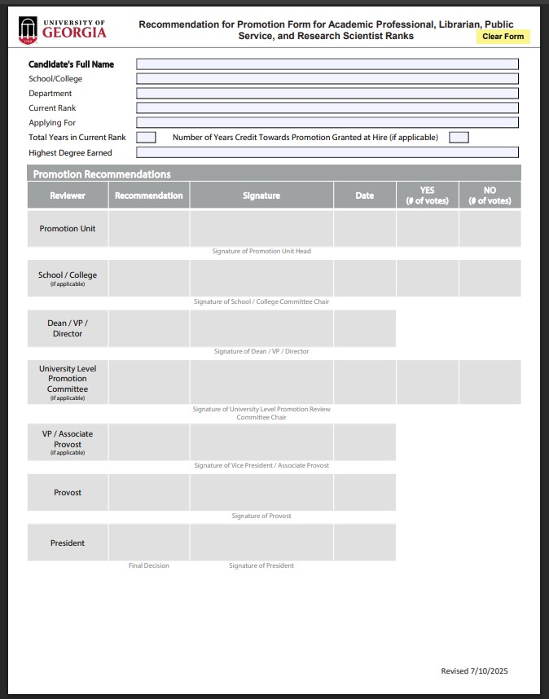
New Recommendation Form
outreach.uga.edu

Slide 40
Summary Narrative Since Last Promotion or Appointment
This form cannot exceed one page
Narrative should include highlights:
Budgeted and assigned duties (including geographic work area)
Professional achievements
Publications, awards, honors, contracts, and grants
Other (including university service, formal instruction, research, and/or significant community service)
outreach.uga.edu

Slide 41
File 3
Section F: Appendix with Performance Evaluation
Faculty evaluations (starting with calendar year 2023 performance) will be included in promotion and/or tenure dossiers (e.g., 2026 – 2027 dossiers will include three prior evaluations)
This is a University System of Georgia Board of Regents Policy (8.3.5.1)
For purposes of dossier preparation, candidates will add a new Appendix, which is a copy of the supervisor’s original written annual reviews, including any faculty response to the annual reviews. (See page 23)
Office of Faculty Affairs statement: As a guiding principle, discretion to the benefit of the candidate should be applied when evaluating faculty under the revised policies and guidelines.
outreach.uga.edu

Slide 42
Submission Procedure
One (1) original hard copy and
One (1) electronic copy on a USB flash drive in PDF format
Separated into 3 PDF files:
          Sections A-E should be a PDF file created from Microsoft Word document (File 1)
          Section F should be a PDF file created from scan of original promotion form and include the final summary narrative (File 2)
            Note: must have original form with original signatures in the hard copy
          Appendix should be a PDF file of annual written evaluations (File 3)
Any document containing original signatures should be scanned into a PDF
outreach.uga.edu

Slide 43
Promotion Procedures
Matt Bishop
Associate Vice President for Public Service and Outreach
(706) 542-6045
mlbishop@uga.edu

Slide 44
Promotion Procedures (1)
Promotion recommendations originate in the administrative unit which the candidate is assigned
Candidates prepare their complete dossier for consideration
Unit Public Service faculty meet to evaluate candidates’ completed dossier
  Eligible voting faculty members must be 51 percent or more public service assignment, and at or above each candidate’s proposed rank
Recommendations are made by written ballot for each candidate and are made part of the candidate’s dossier
After vote is taken, a minority vote report may be filed by one or more committee members within 48 hours of committee decision for inclusion in the dossier’s succeeding review
If administrator’s recommendation is different than the committee vote, a full explanation should be included in the transmittal letter
outreach.uga.edu

Slide 45
Promotion Procedures (2)
If there is an insufficient number of Public Service faculty in the unit to form a committee then the administrator should solicit assistance from VPPSO
Successful candidates continue to University committee for consideration; dossiers are due to VPPSO by October 5, 2026
University committee is comprised of PSO faculty at or above each candidate’s proposed rank
Candidates nominated but not promoted the previous year can reuse appropriate materials, but new materials and letters are expected
outreach.uga.edu

Slide 46
Guidelines for Deliberations (Page 24)
Appointment or promotion rests ultimately on the professional judgments of the decision makers and how they view the evidence submitted to them.
It is the responsibility of each candidate to submit a complete and clear dossier for consideration. The advisory committee will deliberate each dossier against the definitions, requirements, and promotion criteria for the particular rank.
Reviewers assess the totality of the candidate’s contributions based on elements of quality performance that are often not easy to quantify, such as productivity and reputation and the concentration and diversity of work.
outreach.uga.edu

Slide 47
Guidelines for Deliberations
Reputation and productivity. Consistent performance and productivity required of the rank. As the candidate progresses through the ranks, superior accomplishments should be reflected by his/her increasing professional reputation and viewed as beneficial to the overall reputation of the university.
B. Concentration versus diversity. Some candidates may present a diverse portfolio of outstanding work, while other candidates may present a record of outstanding quality and quantity of work in only one category (i.e., instruction and training, applied research, or consultation and technical assistance). The key point is to measure achievement in these categories according to the job responsibilities assigned and the opportunities that position provides or requires for either concentration or diversification of activities.
outreach.uga.edu

Slide 48
Overall Considerations
Candidates are evaluated on superior accomplishments
Successful candidates go beyond acceptable performance
Candidates evaluated on contributions to the outstanding reputation of PSO and UGA
Candidates should be recognized leaders in their professional expertise
Doing their job vs. going above and beyond
Reputation vs. productivity
Lack of terminal degree and experience
Concentration vs. diversity
outreach.uga.edu

Slide 49
Deliberation Process
Committee comprised across Public Service and Outreach faculty
Reader 1
Reader 2
Group deliberation in executive session
Voting by secret ballot
Unsuccessful candidates’ deans/directors are notified by next day
outreach.uga.edu

Slide 50
Appeal Procedure
Unsuccessful nominations for promotion at the university level may be appealed
Appeal requests must be submitted in the form of a letter from the unit administrator to VPPSO within seven (7) days of notification
This letter is the only new information allowed
The letter of appeal must be based on the original dossier contents
Separate committee appointed to review appeals
Not the responsibility of appeals committee to conduct an additional comprehensive review of dossier. Appeal Committee critically analyzes the letter of appeal relative to university committee’s vote to determine if there are stark and substantial grounds for disagreement with the original decision.
Unit/department appeals are handled at the unit/department level based on established procedures
outreach.uga.edu

Slide 51

Questions?
Matt Bishop
Associate Vice President for Public Service and Outreach
(706) 542-6045
mlbishop@uga.edu
Danny Bivins
Senior Public Service Associate
(706) 583-0856
dbivins@uga.edu
Keri Hobbs
Senior Public Service Associate
(706) 583-0052
klgandy@uga.edu

